Slide 1
Extreme Programming
Lecturer: Ngo Huy Bien
Software Engineering Department
Faculty of Information Technology
VNUHCM - University of Science
Ho Chi Minh City, Vietnam
nhbien@fit.hcmus.edu.vn

Slide 2

Objectives
To present Agile development concepts
To present XP roles
To present XP activities
To present XP products
To apply XP method to develop a software system

Slide 3

Books And Reading
Kent Beck and Cynthia Andres (2004). Extreme Programming Explained: Embrace Change.
Craig Larman (2003). Agile and Iterative Development: A Manager's Guide.

Slide 4
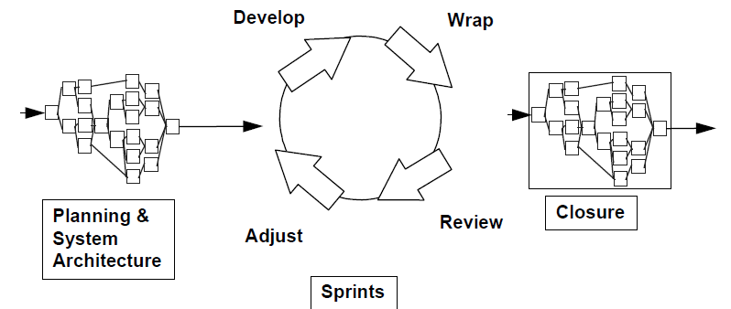
How to Execute Technical Parts of a SCRUM Project?

Slide 5

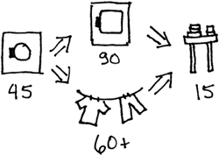
Example [1]
Current state of the laundry process:
What is the bottleneck in this system?
Increasing throughput by hanging clothes to dry:

Slide 6
The Theory of Constraints
The Theory of Constraints says that in any system there is one constraint at a time (occasionally two).
To improve overall system throughput you have to
first find the constraint;
make sure it is working full speed; then
find ways of either increasing the capacity of the constraint, offloading some of the work onto non-constraints, or eliminating the constraint entirely.
How do you find the constraint in a system? – Work piles up in front of the constraint.

Slide 7
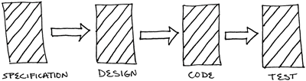
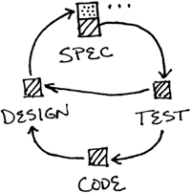
Software Development
Push model of development:
Pull model of development:

Slide 8


Architectural Spike
Architecture spike is exploring solution elements and proceeding ModelFirst until we have something that runs and can be iterated.
Problem domain
Build
Database
Source control tools
System metaphor
(conceptual framework)
Prototype

Slide 9
Pick A Story
What to do with the story?
Too big? – Split it!
Vague - A spike is an experiment that allows developers to learn just enough about the unknown elements in a user story.
It is clear but how to do it?

Slide 10


Slide 11
When To Use XP?
You are in a world of rapid change
You have uncertain requirements

Slide 12
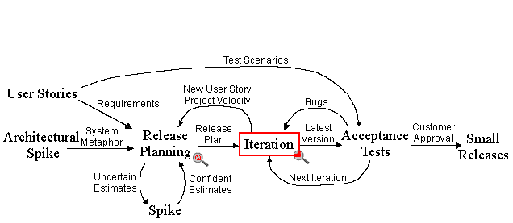
Extreme Programming
Very simplified XP can be seen as Incremental Development mixed with Prototyping, taken to the extreme. It is a reaction to the rigidity of the more formal traditional development processes available. With XP change is expected and embraced. In practice XP relies on a highly experienced team where programmers work in pairs producing code and having users constantly present to give feedback. Deliveries are very frequent (weekly or even daily).

Slide 13
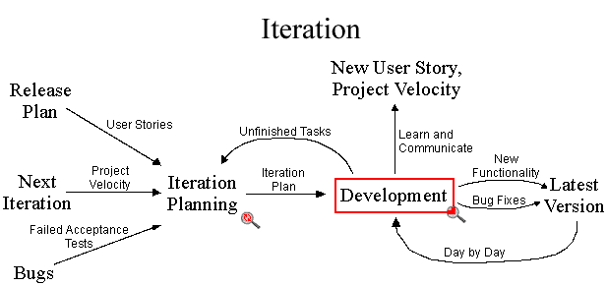
XP Iteration

Slide 14
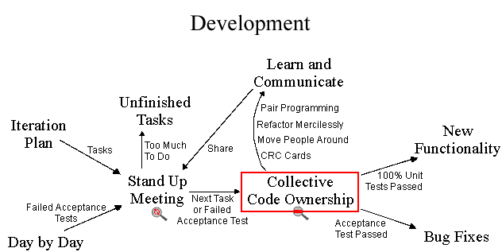
XP Development

Slide 15
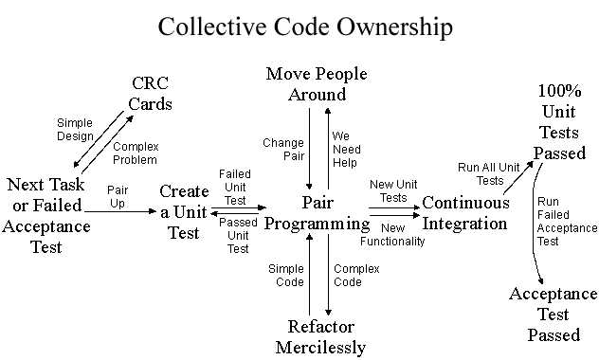
XP Collective Code Ownership

Slide 16
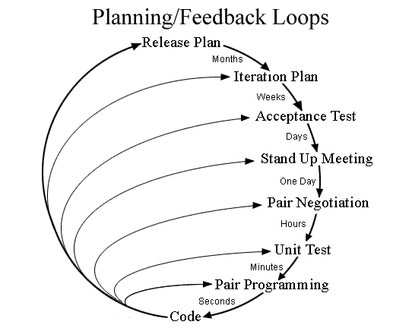
Planning/Feedback Loops

Slide 17
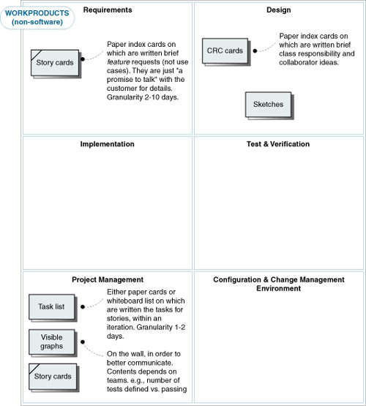
XP Work Products [2]

Slide 18
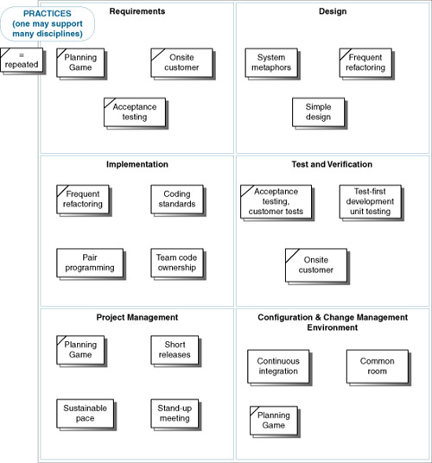
XP Practices

Slide 19
XP Values
Communication
Simplicity
Feedback
Courage

Slide 20

XP Roles
Users
Programmers
Interaction Designers
Project Managers
Technical Writers
Testers
Executives
Architects
Product Managers

Slide 21

Thank You for Your Time

